Slide 1





Search for new phenomena involving top quarks and Higgs bosons with the ATLAS detector
Mirkoantonio Casolino PhD defense
24th February 2017

Slide 2
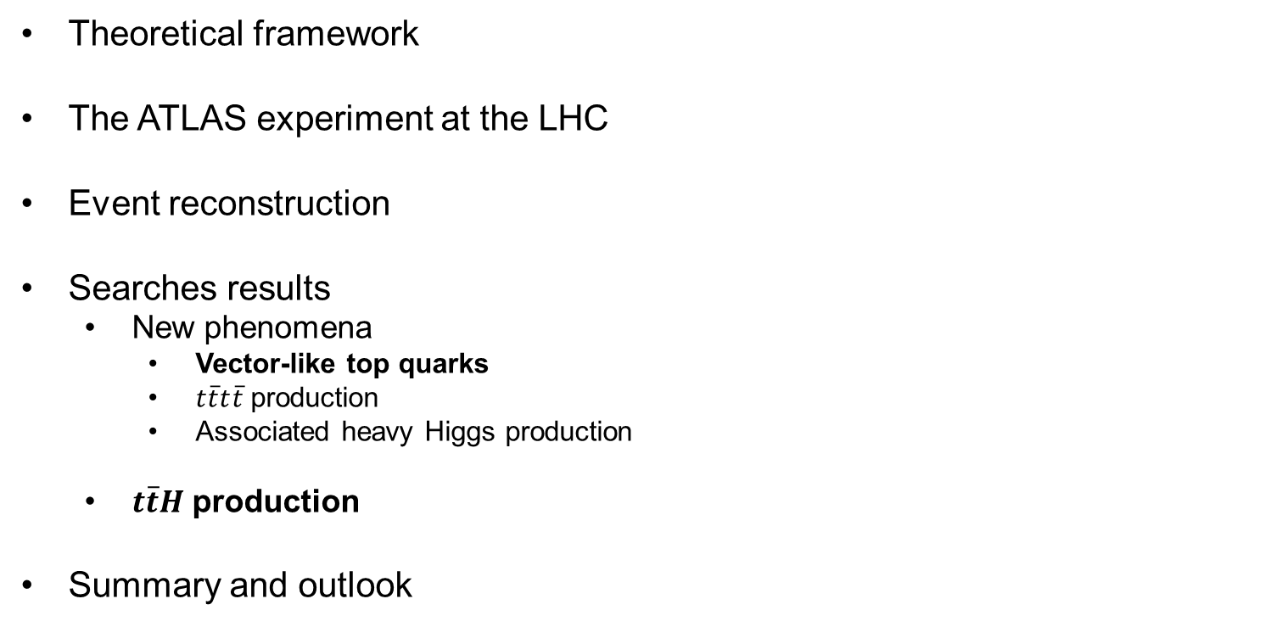
Outline
M. Casolino –PhD defense
Theoretical framework
The ATLAS experiment at the LHC
Event reconstruction
Searches results
New phenomena
Vector-like top quarks
$t\overline{t}t\overline{t}$ production
Associated heavy Higgs production
$t\overline{t}H$ production
Summary and outlook

Slide 3
Theoretical Framework
M. Casolino –PhD defense

Slide 4
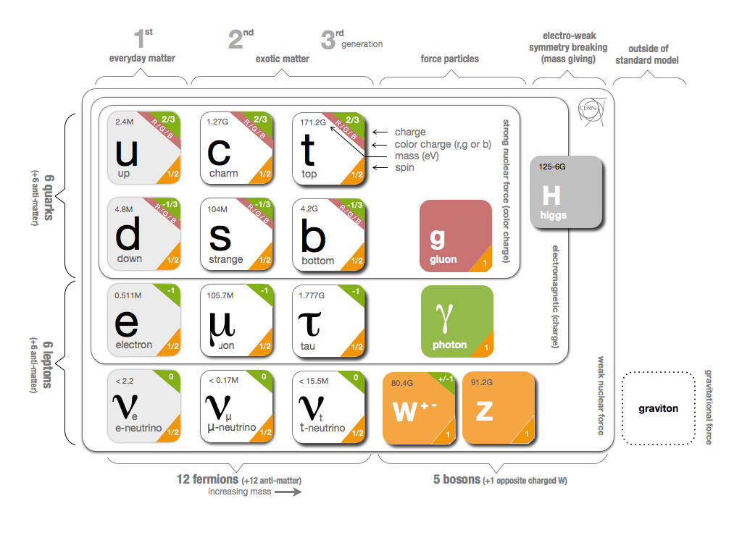
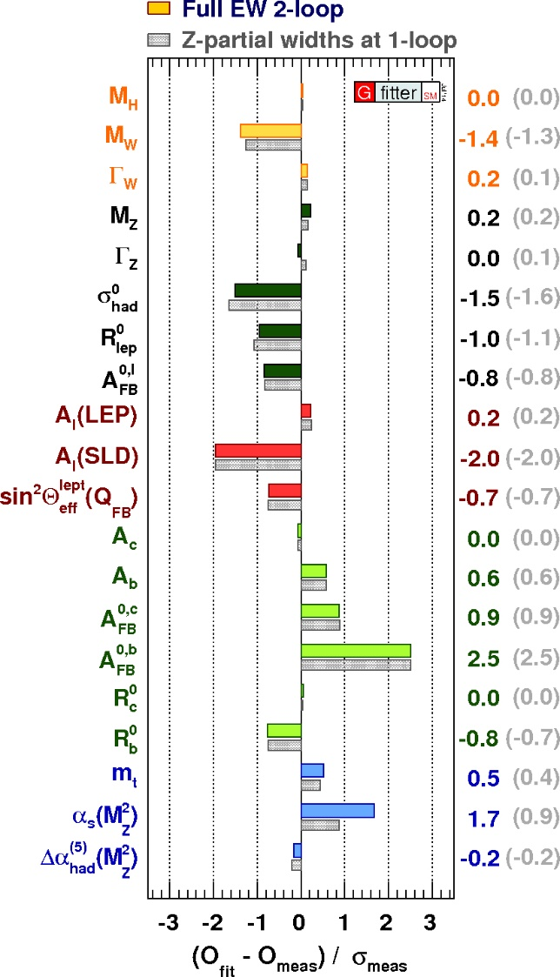
A successful theory
M. Casolino –PhD defense
The Standard Model (SM) describes the interactions between all known elementary particles, accounting for three of the fundamental forces of Nature.

Slide 5

A successful theory
M. Casolino –PhD defense
The Standard Model (SM) describes the interactions between all known elementary particles, accounting for three of the fundamental forces of Nature.

Slide 6

A successful theory
M. Casolino –PhD defense
The Standard Model (SM) describes the interactions between all known elementary particles, accounting for three of the fundamental forces of Nature.

Slide 7
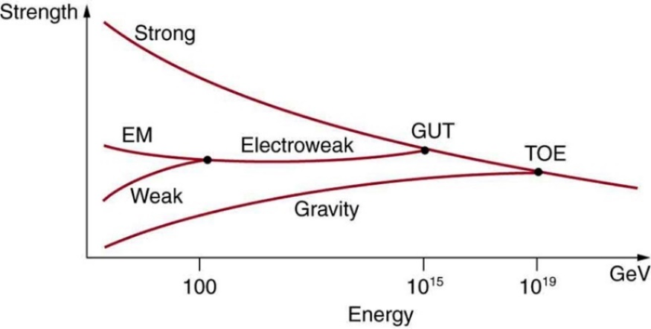
M. Casolino –PhD defense
Really?
Not a complete unified theory, what about gravity?

Slide 8
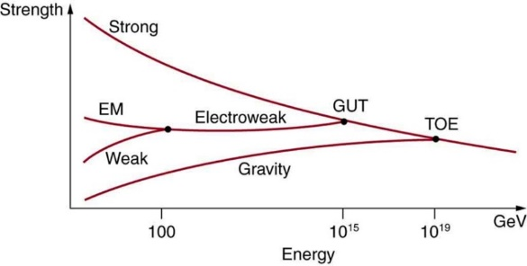
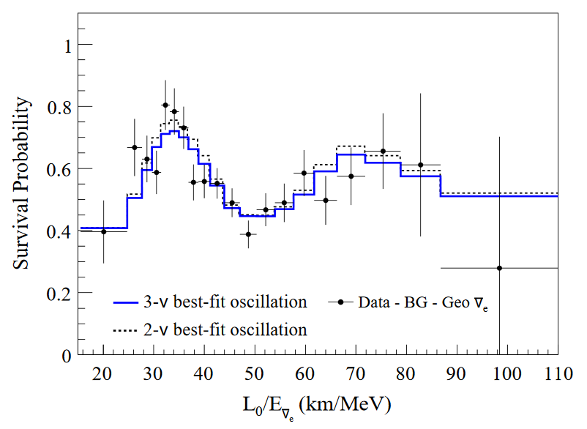
Really?
M. Casolino –PhD defense
Not a complete unified theory, what about gravity?
Why three generations?
No mass term for neutrinos
No enough CP-violation to explain matter-antimatter asymmetry

Slide 9
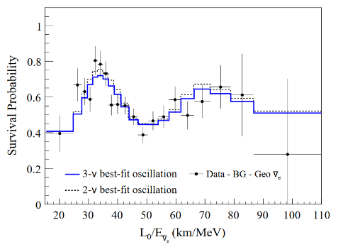
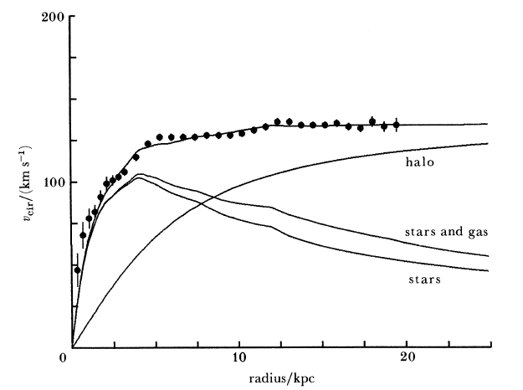

Really?
M. Casolino –PhD defense
Not a complete unified theory, what about gravity?
Why three generations?
No mass term for neutrinos
No enough CP-violation to explain matter-antimatter asymmetry
No candidate for Dark Matter

Slide 10


Really?
M. Casolino –PhD defense
Not a complete unified theory, what about gravity?
Why three generations?
No mass term for neutrinos
No enough CP-violation to explain matter-antimatter asymmetry
No candidate for Dark Matter
Naturalness and Hierarchy problem

Slide 11
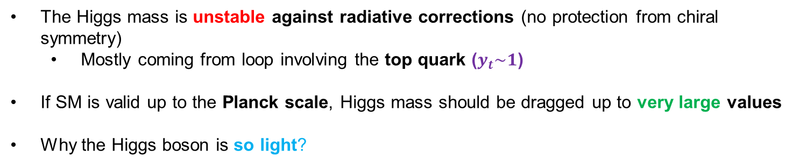
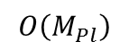
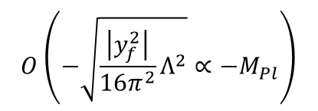
The hierarchy problem
M. Casolino –PhD defense
The Higgs mass is unstable against radiative corrections (no protection from chiral symmetry)
Mostly coming from loop involving the top quark ($y_{t}\sim 1$)
If SM is valid up to the Planck scale, Higgs mass should be dragged up to very large values
Why the Higgs boson is so light?
=
+
+ …
measured mass
bare mass
top-loop correction
=
+
+ …
$$Ο\left(−\sqrt{\frac{\left|y_{f}^{2}\right|}{16π^{2}}Λ^{2}}∝−M_{Pl}\right)$$
125 GeV
$$Ο\left(M_{Pl}\right)$$
Lucky cancellation over 30 orders of magnitude makes the theory highly unnatural

Slide 12
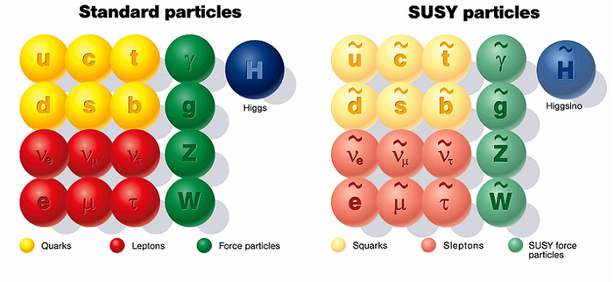

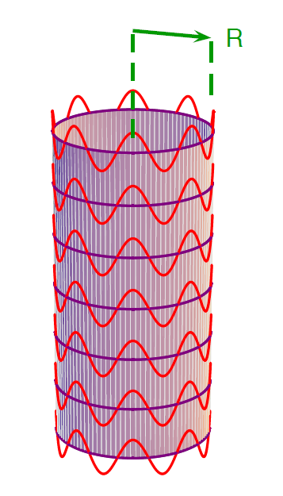


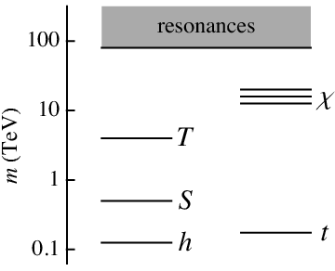
Possible solutions
M. Casolino –PhD defense
Supersymmetry
Extra dimensions
Compositeness

Slide 13
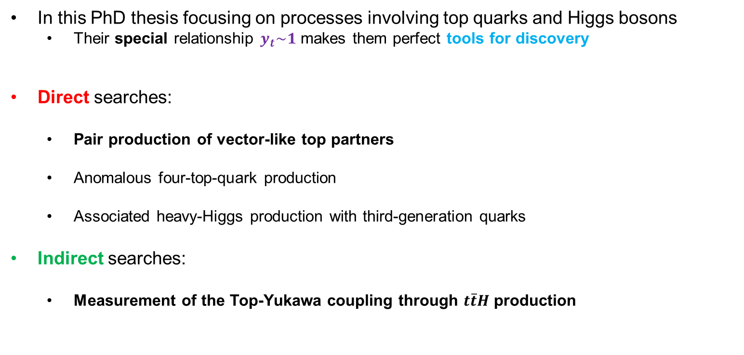
Hunt for New Physics
M. Casolino –PhD defense
In this PhD thesis focusing on processes involving top quarks and Higgs bosons
Their special relationship $y_{t}\sim 1$ makes them perfect tools for discovery
Direct searches:
Pair production of vector-like top partners
Anomalous four-top-quark production
Associated heavy-Higgs production with third-generation quarks
Indirect searches:
Measurement of the Top-Yukawa coupling through $t\overline{t}H$ production

Slide 14
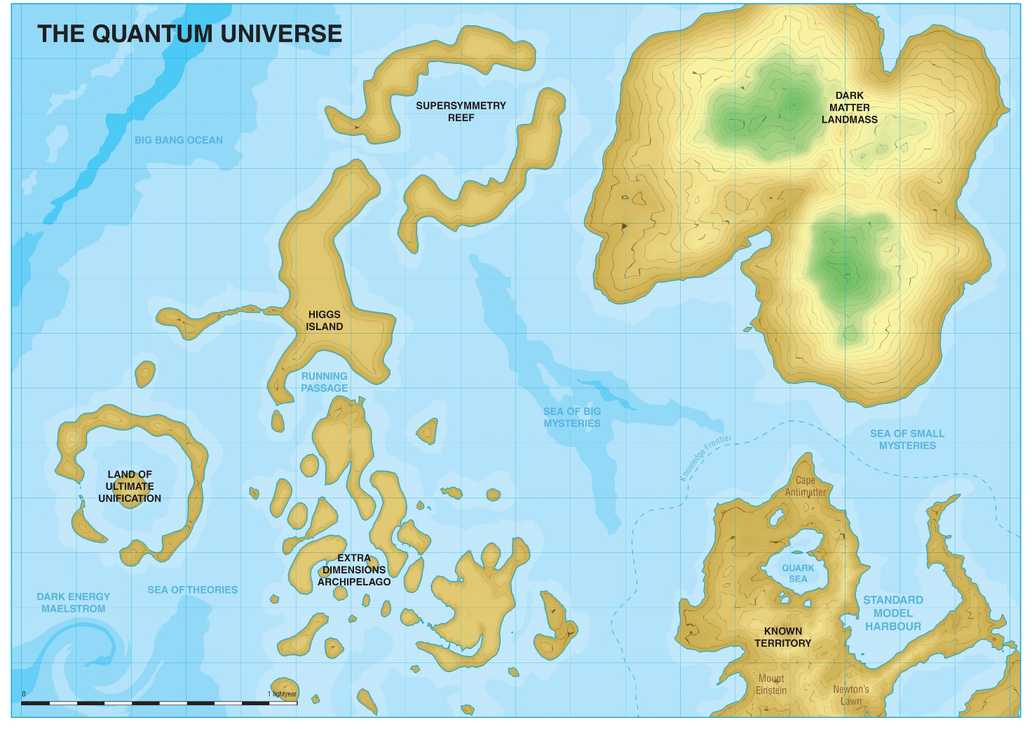
The ATLAS experiment at the LHC
M. Casolino –PhD defense

Slide 15
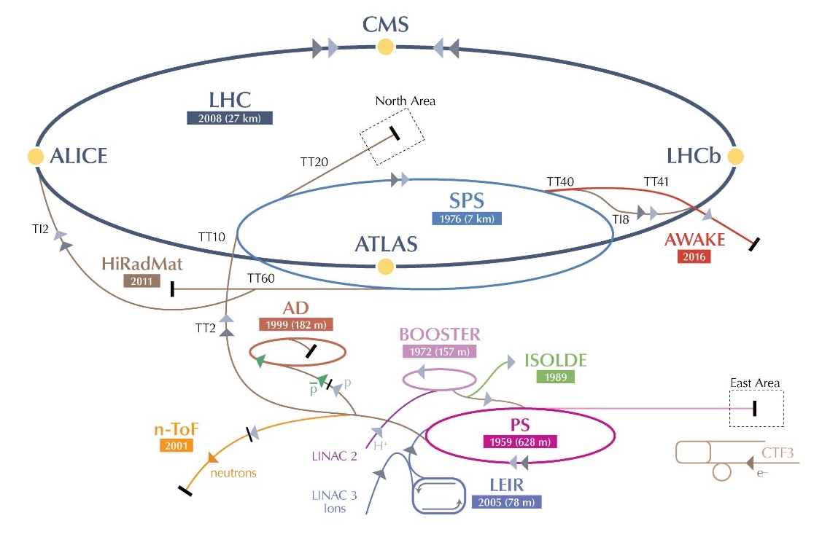
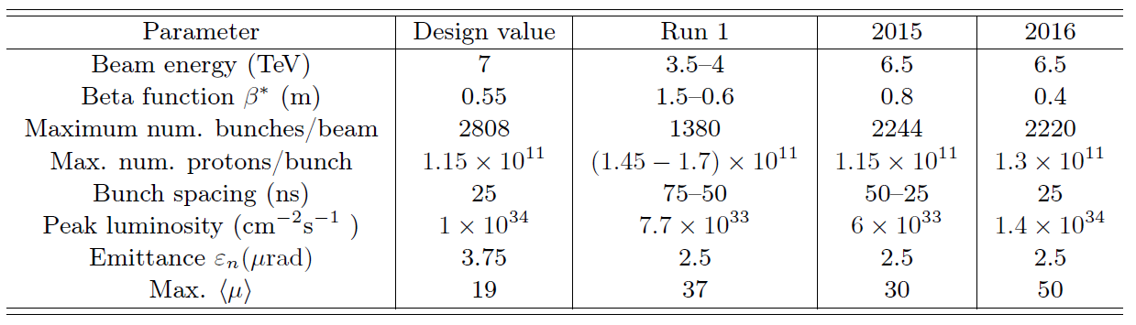
LHC at CERN
M. Casolino –PhD defense
The Lord of the Rings
27 km long superconducting particle collider located ~100 m underground
4 interaction points with 4 big experiments and 3 smaller ones

Slide 16
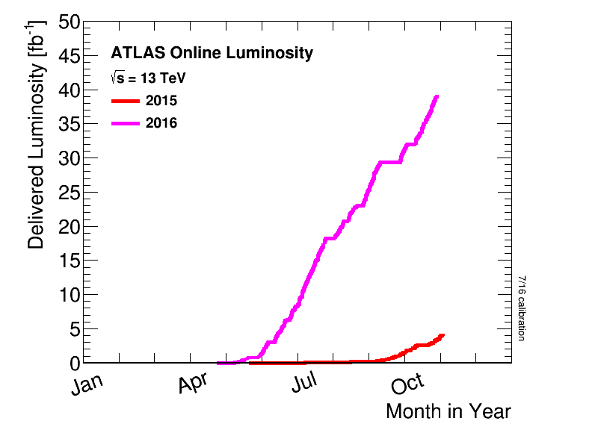
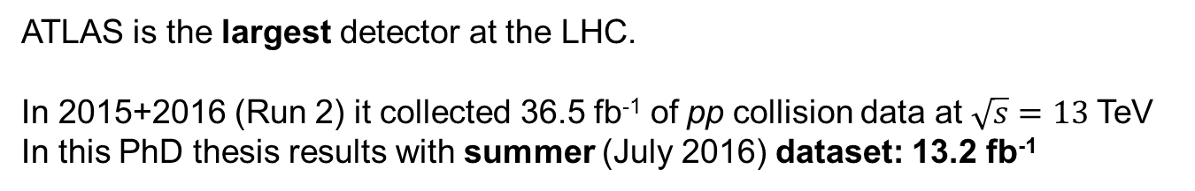
The ATLAS detector
M. Casolino –PhD defense
ATLAS is the largest detector at the LHC. In 2015+2016 (Run 2) it collected 36.5 fb⁻¹ of pp collision data at $\sqrt{s}=13$TeV
In this PhD thesis results with summer (July 2016) dataset: 13.2 fb⁻¹

Slide 17
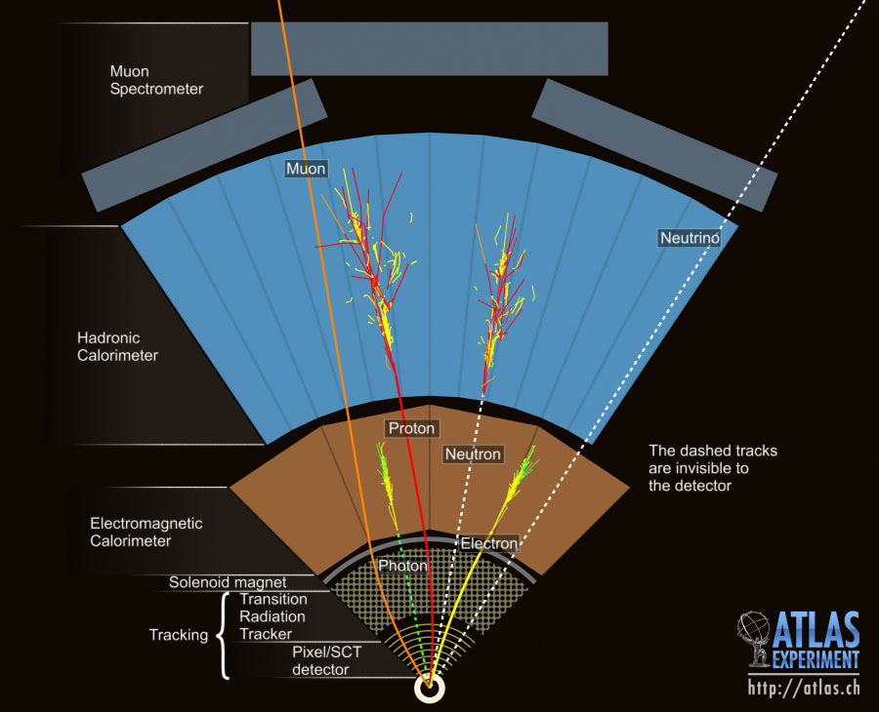
Event reconstruction
M. Casolino –PhD defense

Slide 18
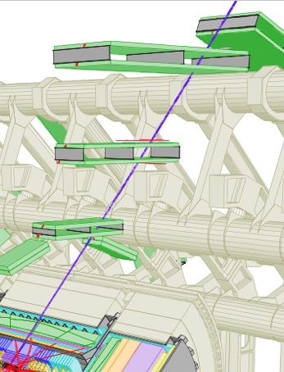
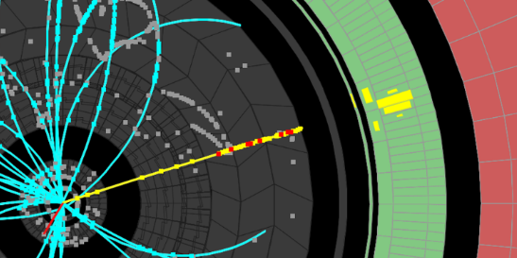
Leptons
M. Casolino –PhD defense
Electrons
Energy deposit in the EM calorimeter associated to a track in the Inner Detector
Muons
Combination of tracks in the Muon Spectrometer and in the Inner Detector
Calibrated using $Z→e^{+}e^{−}/μ^{+}μ^{−}$ and $J/Ψ→e^{+}e^{−}/μ^{+}μ^{−}$ events

Slide 19
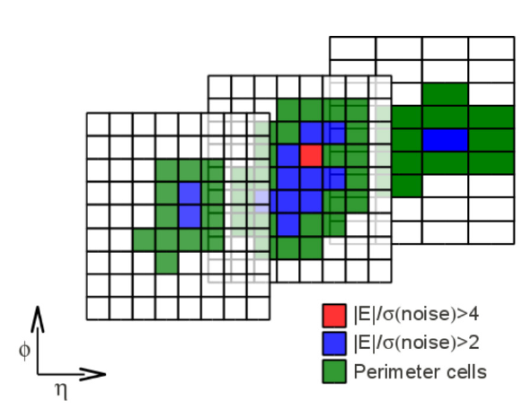
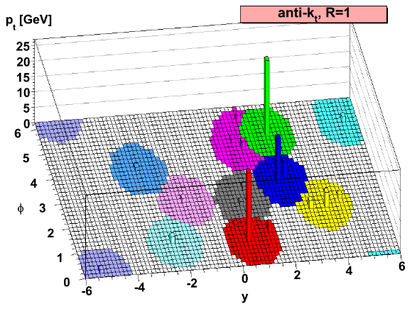
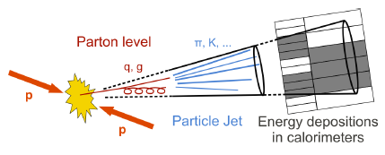
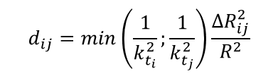
Jets
M. Casolino –PhD defense
Reconstruction
Calorimeter cells are grouped in 3D clusters according to signal/noise ratio
Clusters are combined in jets using anti-k_{T} algorithm with radius R=0.4
$$d_{ij}=min\left(\frac{1}{k_{t_{i}}^{2}};\frac{1}{k_{t_{j}}^{2}}\right)\frac{∆R_{ij}^{2}}{R^{2}}$$
Jet calibration corrects the energy of measured jets back to particle level

Slide 20
Jets
M. Casolino –PhD defense
Small R
Reconstruction
Calorimeter cells are grouped in 3D clusters according to signal/noise ratio
Clusters are combined in jets using anti-k_{T} algorithm with radius R=0.4
$$d_{ij}=min\left(\frac{1}{k_{t_{i}}^{2}};\frac{1}{k_{t_{j}}^{2}}\right)\frac{∆R_{ij}^{2}}{R^{2}}$$
Jet calibration corrects the energy of measured jets back to particle level

Slide 21
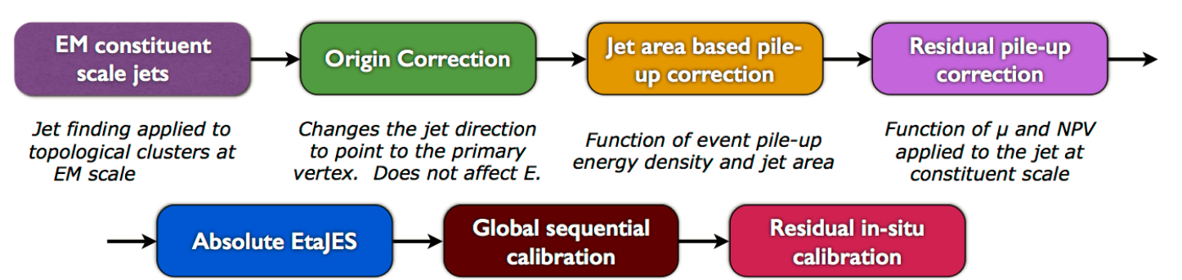
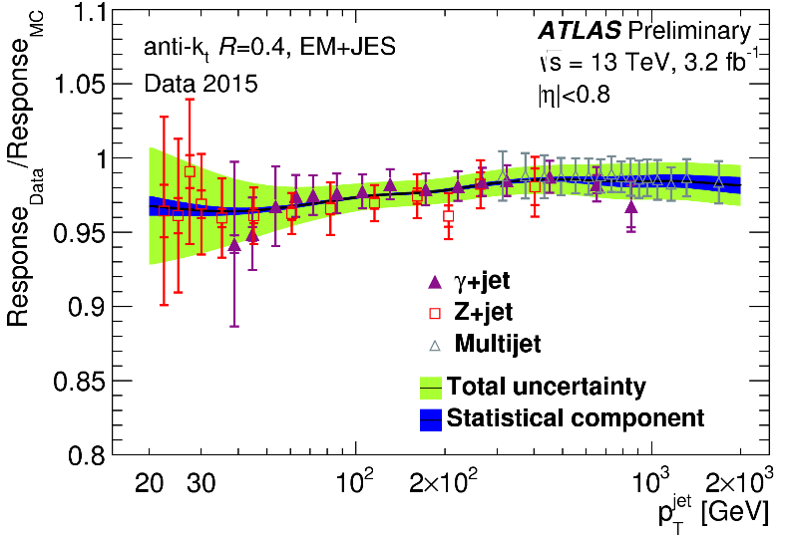
Small-R jets
M. Casolino –PhD defense
Calibration

Slide 22
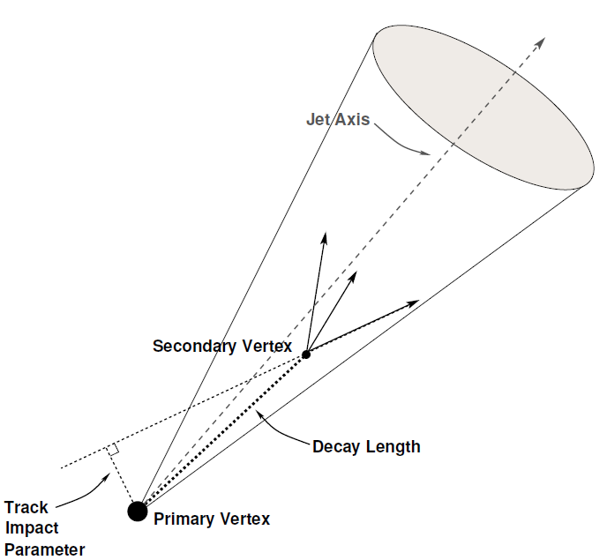
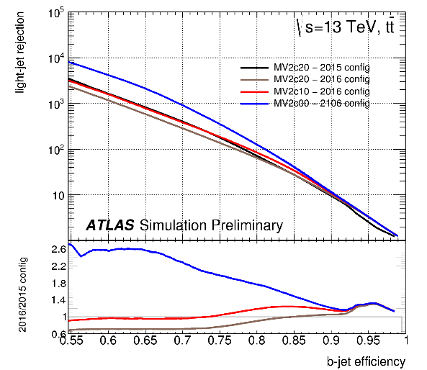
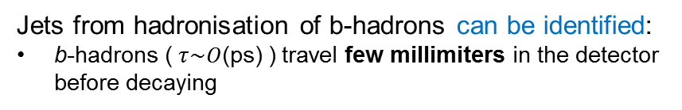
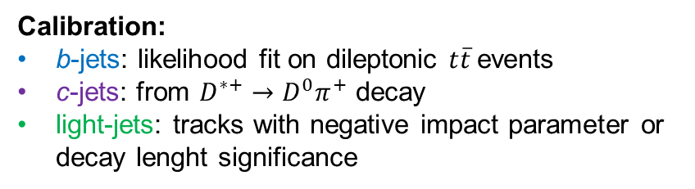
b-jets
M. Casolino –PhD defense
Identification and calibration
Jets from hadronisation of b-hadrons can be identified:
b-hadrons ($τ\sim O$(ps) ) travel few millimiters in the detector before decaying
MV2c10 multivariate technique (BDT) combines:
Track impact parameter
Secondary vertex
b-hadron decay chain
70% efficiency, light (charm) rejection of 380 (12):
~2.5 better light and charm rejection with respect to Run 1 thanks to additional pixel layer (IBL)
Calibration:
b-jets: likelihood fit on dileptonic $t\overline{t}$events
c-jets: from $D^{∗+}→D^{0}π^{+}$ decay
light-jets: tracks with negative impact parameter or decay lenght significance

Slide 23
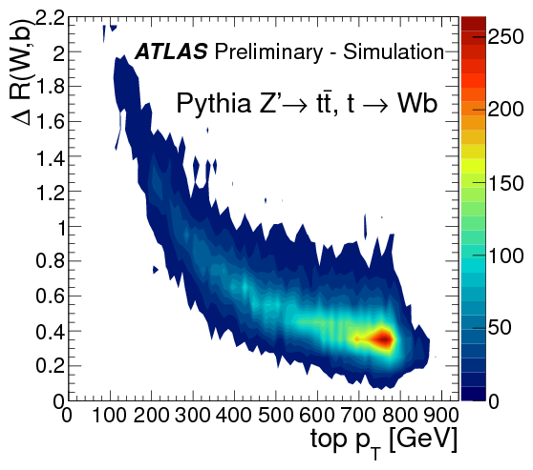
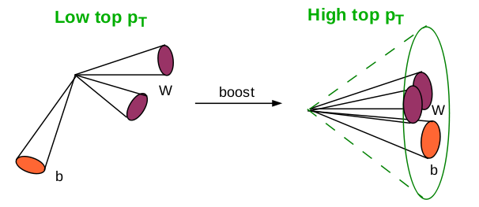
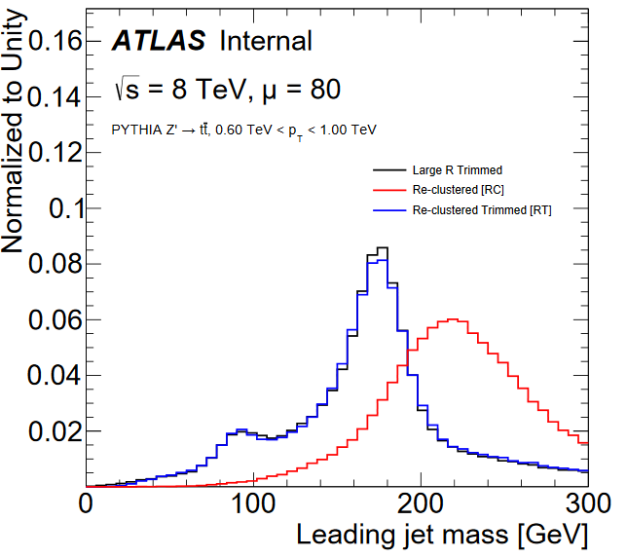
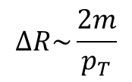
Large-R jets
M. Casolino –PhD defense
Hadronically-decaying heavy particles with $p_{T}≫m$ can be reconstructed as single large-R jets
$$∆R\sim \frac{2m}{p_{T}}$$
Large-R jets using anti-k_{T} algorithm with radius R=1.0
In these analyses reclustering is used:
large-R jets built from small-R jets and trimmed
calibration and uncertainties are inherited from small-R jets
comparable performance to standard large-R jets

Slide 24
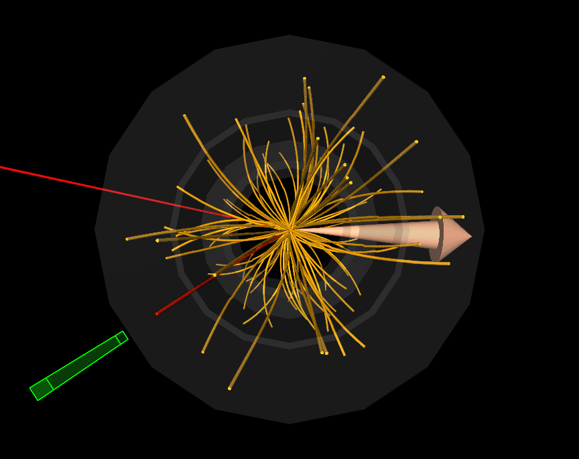

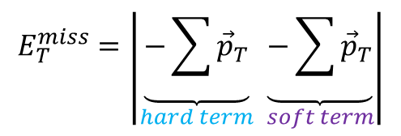
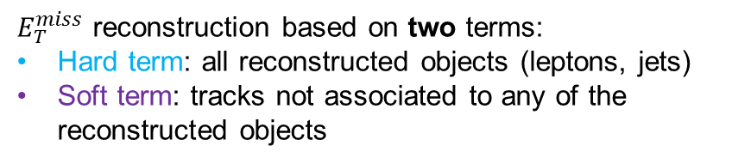
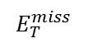
Missing transverse energy ($E_{T}^{miss}$)
M. Casolino –PhD defense
ATLAS not sensitive to weakly-interacting particles:
create a momentum imbalance in the beam transverse plane
Electron
$E_{T}^{miss}$ reconstruction based on two terms:
Hard term: all reconstructed objects (leptons, jets)
Soft term: tracks not associated to any of the reconstructed objects
Muon
$$E_{T}^{miss}$$
$$E_{T}^{miss}=\left|\underset{hard term}{\underbrace{−\sum{{\vec{p}}_{T}}}} \underset{soft term}{\underbrace{−\sum{{\vec{p}}_{T}}}}\right|$$
$E_{T}^{miss}$ calibrated using $Z→l^{+}l^{−}$, $W^{±}→l^{±}ν$ and $t\overline{t}$ events

Slide 25

Search for new phenomena in $t\overline{t}$ final states with additional heavy flavour jets
M. Casolino –PhD defense

Slide 26

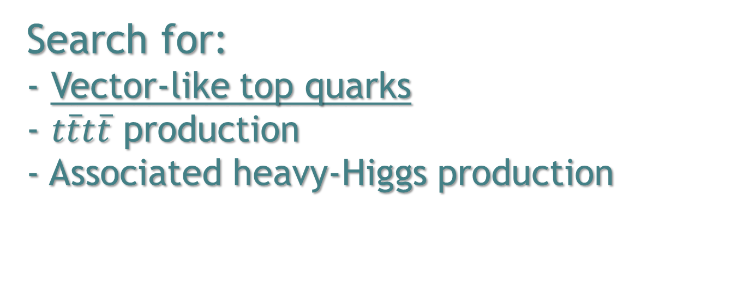
Search for: - Vector-like top quarks - $t\overline{t}t\overline{t}$ production - Associated heavy-Higgs production
M. Casolino –PhD defense

Slide 27
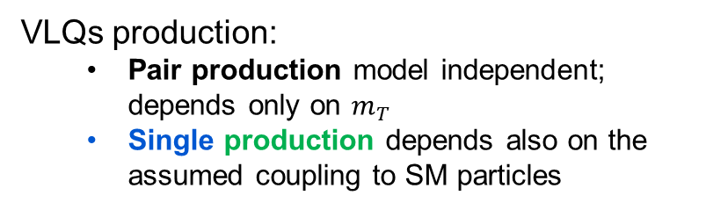
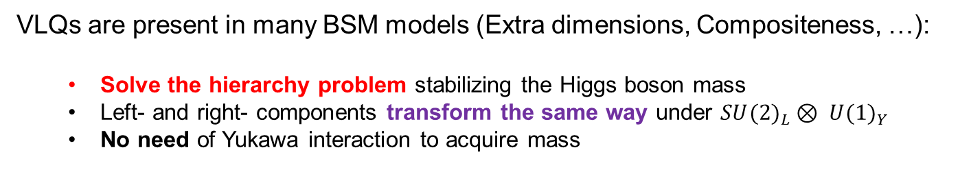
Vector-like quarks (VLQ)
M. Casolino –PhD defense
VLQs are present in many BSM models (Extra dimensions, Compositeness, …):
Solve the hierarchy problem stabilizing the Higgs boson mass
Left- and right- components transform the same way under ${SU(2)}_{L}⊗ {U(1)}_{Y}$
No need of Yukawa interaction to acquire mass
VLQs production:
Pair production model independent; depends only on $m_{T}$
Single production depends also on the assumed coupling to SM particles

Slide 28
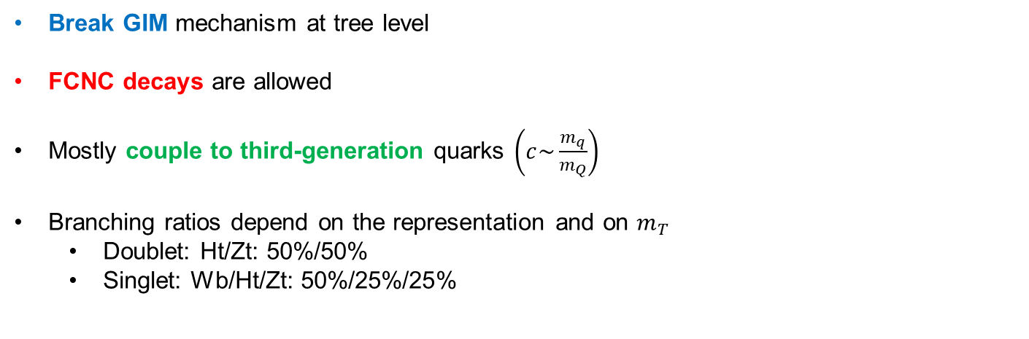
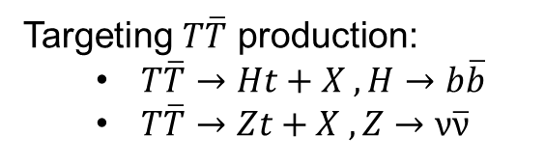
Vector-like quarks (VLQ)
M. Casolino –PhD defense
Break GIM mechanism at tree level
FCNC decays are allowed
Mostly couple to third-generation quarks $\left(c\sim \frac{m_{q}}{m_{Q}}\right)$
Branching ratios depend on the representation and on $m_{T}$
Doublet: Ht/Zt: 50%/50%
Singlet: Wb/Ht/Zt: 50%/25%/25%
Targeting $T\overline{T}$ production:
$T\overline{T}→Ht+X , H→b\overline{b}$
$T\overline{T}→Zt+X , Z→ν\overline{ν}$

Slide 29
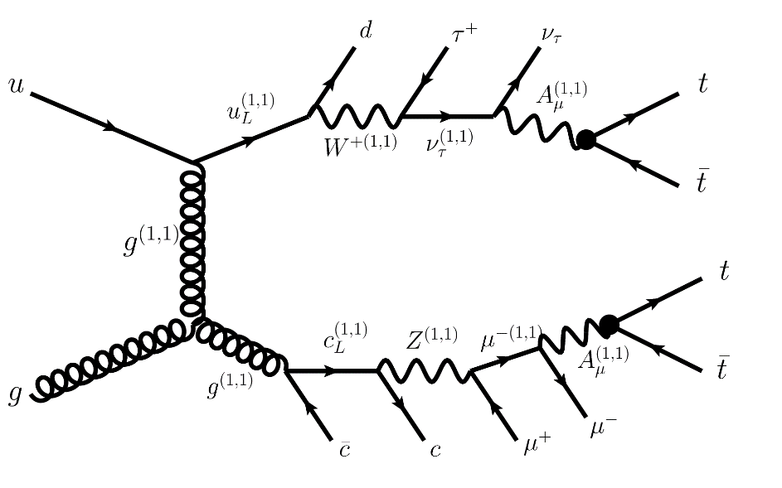
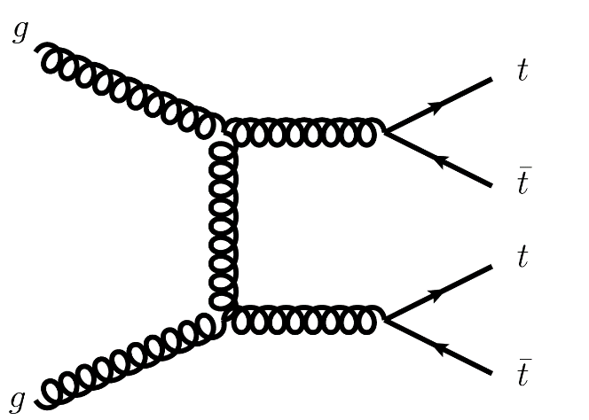
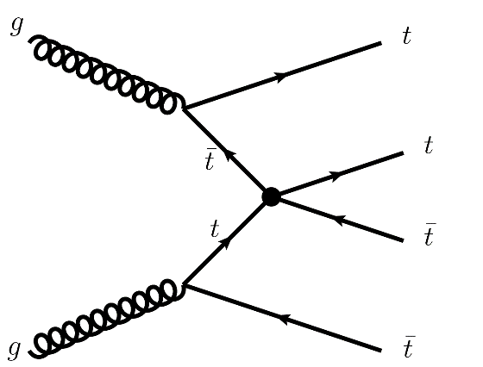
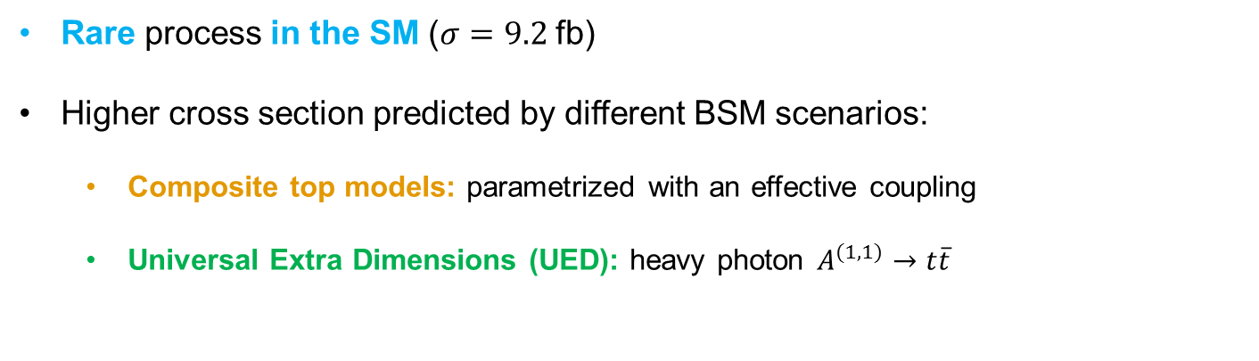

$t\overline{t}t\overline{t}$ production
M. Casolino –PhD defense
Rare process in the SM ($σ=9.2$fb)
Higher cross section predicted by different BSM scenarios:
Composite top models: parametrized with an effective coupling
Universal Extra Dimensions (UED): heavy photon $A^{(1,1)}→t\overline{t}$
SM
Effective Coupling
UED

Slide 30




Associated heavy-Higgs production
M. Casolino –PhD defense
Two Higgs doublets (SUSY models, 2HDM) lead to five physical states: $h$, $H/A$, $H^{±}$
Heavy neutral higgs:
If $m_{H/A}>$ 350 GeV, main decay $H/A →t\overline{t}$ in the alignment limit
For $gg→H/A→t\overline{t}$ peak-dip structure in the $m_{t\overline{t}}$ spectrum due to interference effects with SM $t\overline{t}$ production
At higher masses resolution effects wash out the structure
Associated production with third-generation quarks gives a possibility to exploit this scenario
arXiv:1611.08119
Charged Higgs:
$t{bH}^{±}$ production gives access to $H^{±}→tb$
Main decay mode for $m_{H^{±}}>$200 GeV in the alignment limit

Slide 31


A common signature
M. Casolino –PhD defense
All presented signals share the presence of a $t\overline{t}$ pair in association with:
$H→b\overline{b}$ or $Z→ν\overline{ν}$ for VLQ
$t\overline{t}$ or $b\overline{b}$ pair for associated heavy-Higgs production
$t\overline{t}$ for four-top-quark production
$t\overline{t}$ pair final state defined by the decay of the W boson
Events are preselected in two channels:
Lepton+jets (1L)
One isolated lepton $\left(e or μ\right)$
Single-lepton triggers
≥5 jets, ≥2 b-tags
$E_{T}^{miss}$>20 GeV and $E_{T}^{miss}+m_{T}^{W}>$ 60 GeV
Jets+$E_{T}^{miss}$(0L)
No lepton and high (>200 GeV) $E_{T}^{miss}$
Trigger on $E_{T}^{miss}$
≥6 jets, ≥2 b-tags
${∆ϕ }_{min}^{4j}$> 0.4
After preselection single-lepton $t\overline{t}$+ jets production is the dominant background

Slide 32





Analysis strategy
M. Casolino –PhD defense
Designing analysis regions
Some variables allow to design more precise/refined selections
These selections have as goal defining regions with different S/B ratios
ed
design more
Number of jets and b-tags:
Signal has busier final state
$m_{bb}^{min∆R}$
exploits the presence of boosted $H→b\overline{b}$
$m_{T,min}^{b}$: between b-jets and $E_{T}^{miss}$
Jacobian peak for background
LM
LM
HM
HM

Slide 33



Analysis strategy
M. Casolino –PhD defense
Mass-tagged jets and discriminant variable
High-mass VLQ can produce boosted hadronic resonances ($t, W, Z, H$)
Need to tag different resonances
High efficiency and simple tagger based on the mass (m>100 GeV) of a reclustered large-R jet
Multiplicity of mass-tagged jets has good discrimination power between signal and background
The targeted signals produce leptons and jets with high energy
The chosen discriminant variable is $m_{eff}$:
$$m_{eff}=\sum_{jets}{p_{T}}+p_{T}^{lep}+E_{T}^{miss}$$
Good discrimination for all signals

Slide 34



Analysis strategy
M. Casolino –PhD defense
Event categorization – 1L
1L
Categorize events using n_{jets}, n_{b-tags}, n_{mass-tagged}
Use $m_{bb}^{min∆R}$($≷$100 GeV) to improve $\frac{S}{B}$and $\frac{S}{\sqrt{B}}$ in some regions
Simultaneous likelihood fit of m_{eff} shape in signal-rich (SR) and signal-depleted (CR) regions
Test a possible signal
Constrain in situ the leading systematic uncertainties
Most sensitive regions with high mass-tagged and b-tag multiplicities
Check fit results in validation regions (VR)
13.2 fb⁻¹
$T\overline{T}$ doublet (800 GeV)
LM
LM
HM
HM
CR/SR
VR

Slide 35


Backgrounds
M. Casolino –PhD defense
1L
$t\overline{t}$+light-jets and $t\overline{t}+≥1b(c)$ are the main backgrounds
Modelling across analysis regions is a crucial aspect for this analysis
Powheg+Pythia6 (PP6) used as baseline MC, NLO description of inclusive $t\overline{t}$ production
Derived corrections to improve the modelling
Small backgrounds:
$W/Z$+jets
Single top quark production
Diboson production
$t\overline{t}+X$ with $X=V,H,$ $t\overline{t}$
Multijet

Slide 36



$t\overline{t}+$light-jets modelling
M. Casolino –PhD defense
The top-quark $p_{T}$ discrepancy
PP6 predicts a harder top-quark $p_{T}$ spectrum than in data
Eur. Phys. J. C76 (2016) 538
ATLAS-CONF-2016-040

Slide 37

$t\overline{t}+$light-jets modelling
M. Casolino –PhD defense
The top-quark $p_{T}$ discrepancy
PP6 predicts a harder top-quark $p_{T}$ spectrum than in data
Related to missing NNLO corrections
Reweight PP6 using the distribution at NNLO

Slide 38




$t\overline{t}+≥1b$modelling
M. Casolino –PhD defense
Classification of events based on truth matching (partons, hadrons and particle-level jets)
PP6 only leading-log accuracy
70% uncertainty at LO vs 30% at NLO
Reweight kinematics to state-of-art calculations @NLO in 4F scheme (massive b-quarks)
ATL-PHYS-PUB-2016-016

Slide 39







Data/MC comparison
M. Casolino –PhD defense
Comparison at preselection level: $≥5 (6)$ jets, $≥2$ b-tags for 1L (0L) channel
Some discrepancies observed
Number of jets
Number of b-tags
m_{eff}
0L
1L

Slide 40

Data/MC comparison
M. Casolino –PhD defense
Comparison at preselection level: $≥5 (6)$ jets, $≥2$ b-tags for 1L (0L) channel
Some discrepancies observed → covered by systematic uncertainties
Number of jets
Number of b-tags
m_{eff}
0L
1L

Slide 41


Systematic uncertainties
M. Casolino –PhD defense
Very sophisticated systematic model
Breakdown into components for a flexible model
Main experimental uncertainties:
Jet energy scale
b(c)-tagging and mistagging
Normalization uncertainties for small backgrounds
Detailed modelling for $t\overline{t}$+jets

Slide 42


$t\overline{t}$+jets uncertainties
M. Casolino –PhD defense
$t\overline{t}$inclusive NNLO cross section uncertainty ~6%
50 % $t\overline{t}+≥1c$ normalization uncertainty
$t\overline{t}+≥1b$ normalization free floating in the fit; determined from data
Uncertainty related to differential NNLO calculation ^{(†)}
^{(†)} not applied to $t\overline{t}+≥1b$
Parton shower uncertainty ^{(*)}: Difference with Powheg+Herwig
Radiation model uncertainty ^{(*)}: scale variations, Powheg parameters and PS tune
NLO matrix element uncertainty^{(*):} Difference with aMC@NLO
^{(*)} uncorrelated across $t\overline{t}$+light-jets, $t\overline{t}+≥1c$, $t\overline{t}+≥1b$
Only for $t\overline{t}+≥1b$ : from NLO samples
PDF uncertainties
Scales uncertainties
Parton Shower, Underlying Event and Multi-Parton Interaction modelling
Parton shower and NLO model: comparison with NLO 4F samples

Slide 43




Statistical analysis
M. Casolino –PhD defense
Intermezzo
Test two hypotheses using a signal strength modifier $μ=\frac{σ}{σ_{theory}}$:
$μ$=0 → H₀ : the B-only hypothesis
$μ$=1 → H₁ : the S+B hypothesis
p-value quantifies agreement of data with given hypothesis:
$p_{0}$agreement with B-only hypothesis
$p_{μ}$agreement with S+B hypothesis
Profile likelihood ratio used to compute p-value
Built from Poisson probabilities for all bins and systematic uncertainties pdf (Nuisance Parameters)
Maximizing the likelihood will result in improved data/MC agreement and reduced uncertainties
To avoid rejection in case of not enough sensitivity: CL_{s} method Exclude signal hypothesis at 95% CL if:
$$q_{μ}=\frac{L\left(μ,\hat{\hat{θ}}(μ)\right)}{L\left(\hat{μ},\hat{θ}(μ)\right)}$$
${CL}_{s}=\frac{p_{μ}}{1−p_{0}}≤0.05$

Slide 44




Fit results
M. Casolino –PhD defense
Pre-fit
Post-fit (B-only)
1L
1L
CR/SR
0L
0L
Improved data/MC agreement and reduced uncertainties post-fit
Very good modelling across large phase space
Fit results able to describe VR quite well!
1L
0L
1L
0L
VR

Slide 45












Fit results
M. Casolino –PhD defense
1L shape plots
Subset of 1L regions
Improved data/MC agreement and reduced uncertainties post-fit
Very good modelling of the shape
Unfortunately no significant excess!
$$0J,≥6j,≥4b$$
$$1J,≥6j,≥4b,LM$$
$$1J,≥6j,≥4b,HM$$
$$≥2J,≥6j,≥4b$$
Pre-fit
Post-fit (B-only)

Slide 46












Fit results
M. Casolino –PhD defense
0L shape plots
Subset of 0L regions
Improved data/MC agreement and reduced uncertainties post-fit
Very good modelling of the shape
Unfortunately no significant excess!
$$1J,≥7j,≥4b,HM$$
$$≥2J,≥7j,2b$$
$$≥2J,≥7j,3b,HM$$
$$≥2J,≥7j,≥4b$$
Pre-fit
Post-fit (B-only)

Slide 47




Limits
M. Casolino –PhD defense
No significant excess observed, set limits in different scenarios
Limits as a function of mass for a vector-like top
Using 1L and 0L combination
Extend the sensitivity compared to previous searches by ~200-300 GeV
$m_{T}>1.02$ TeV
$m_{T}>1.16$ TeV

Slide 48


Model independent limits
M. Casolino –PhD defense
Remove the assumption on the branching ratios
$$BR(T→Ht)$$
$$BR(T→Wb)$$

Slide 49
Model independent limits
M. Casolino –PhD defense
Remove the assumption on the branching ratios
$BR\left(T→Wb\right)+BR\left(T→Zt\right)+BR\left(T→Ht\right)=1$
$$BR(T→Ht)$$
Forbidden by
BR unitarity
$$BR(T→Wb)$$

Slide 50



Model independent limits
M. Casolino –PhD defense
Remove the assumption on the branching ratios
$BR\left(T→Wb\right)+BR\left(T→Zt\right)+BR\left(T→Ht\right)=1$
Different analyses are sensitive to different parts of the triangle
$$BR(T→Ht)$$
Ht+X
1L
Forbidden by
BR unitarity
Zt+X
Wb+X
$$BR(T→Wb)$$

Slide 51
Model independent limits
M. Casolino –PhD defense
Remove the assumption on the branching ratios
$BR\left(T→Wb\right)+BR\left(T→Zt\right)+BR\left(T→Ht\right)=1$
Different analyses are sensitive to different parts of the triangle
$$BR(T→Ht)$$
Ht+X
1L
Forbidden by
BR unitarity
Ht+X
0L
SS
Zt+X
Wb+X
$$BR(T→Wb)$$

Slide 52



Model independent limits
M. Casolino –PhD defense
$$BR(T→Ht)$$
Ht+X
1L
Combination increases sensitivity respect to simple overlay
Forbidden by
BR unitarity
Ht+X
0L
SS
Zt+X
Wb+X
$$BR(T→Wb)$$

Slide 53

Model independent limits
M. Casolino –PhD defense
$$BR(T→Ht)$$
Ht+X
1L
Combination increases sensitivity respect to simple overlay
Forbidden by
BR unitarity
Ht+X
0L
SS
Zt+X
Wb+X
$$BR(T→Wb)$$
Lowest mass excluded 810 GeV

Slide 54




ATLAS comparison
M. Casolino –PhD defense
ATLAS published searches for VLQ in Wb+X, Zt+X and SS dilepton
No combination of the analyses yet, the overlay can exclude 900 GeV for any BR

Slide 55
ATLAS comparison
M. Casolino –PhD defense
ATLAS published searches for VLQ in Wb+X, Zt+X and SS dilepton
No combination of the analyses yet, the overlay can exclude 900 GeV for any BR
This is currently the most sensitive search for the well-motivated Singlet and Doublet benchmarks, and the one with widest coverage over the BR plane

Slide 56



Limits on $t\overline{t}t\overline{t}$production
M. Casolino –PhD defense
1L channel was reinterpreted in context of $t\overline{t}t\overline{t}$ production in different scenarios
SM: 15 (12) times SM observed (expected) exclusion, CMS 10 (11) times SM
Effective coupling:${\left|C_{4t}\right|}/{Λ^{2}}<$2.9 TeV⁻² (3.0 TeV⁻²) observed (expected)
KK modes in UEDRPP model: exclude $m_{KK}<$1.6 TeV (1.5 TeV) observed (expected)

Slide 57







Limits on associated heavy Higgs production
M. Casolino –PhD defense
1L channel was reinterpreted in context of associated heavy-Higgs production in the 2HDM model
$b\overline{b}H (H→t\overline{t})$: low sensitivity, limited by small signal acceptance
$t\overline{t}H (H→t\overline{t})$: for $m_{H}=$400 GeV $\tan{β}$<0.17 (0.23) observed (expected) exclusion
$\overline{t}bH^{+} (H^{+}→t\overline{b})$: for $m_{H^{+}}=2$00 GeV $\tan{β}$<0.65 (0.55) observed (expected) exclusion
$b\overline{b}H (H→t\overline{t})$
$$t\overline{t}H (H→t\overline{t})$$
$\overline{t}bH^{+} (H^{+}→t\overline{b})$

Slide 58


ATLAS Comparison
M. Casolino –PhD defense
ATLAS published a dedicated search for $\overline{t}bH^{+} (H^{+}→t\overline{b})$ production
At low $m_{H^{±}}$ factor ~5 less sensitive, at high $m_{H^{±}}$ comparable sensitivity

Slide 59


Search for $t\overline{t}H$ production
M. Casolino –PhD defense

Slide 60



Why $t\overline{t}H$?
M. Casolino –PhD defense
Not yet observed at LHC
One of main goals for ATLAS in Run 2
Direct probe of top-Yukawa coupling
Cross section proportional to $y_{t}^{2}$
Experimental proof of the Yukawa interaction via direct measurements is mandatory
Any deviation might be hint of new physics
$t\overline{t}H$ signal strength $(μ_{t\overline{t}H})$ has been measured in LHC Run 1: 4.4σ combined significance, cross-section above SM but consistent within large uncertainty
LHC Run 2 analysis benefits from large increase in $t\overline{t}H$ cross section (x3.8), though backgrounds increase at a comparable rate in the signal regions
$$t\overline{t}H$$

Slide 61



Analysis strategy
M. Casolino –PhD defense
Event categorization
Preselection
One isolated lepton $\left(e or μ\right)$
Single lepton triggers
≥4 jets, ≥2 b-tags
Categorize events using n_{jets}, n_{b-tags}
Signal lives at high jet and b-tag multiplicities
Simultaneous likelihood fit of signal-rich and signal-depleted regions
Test a possible signal
Constraint in situ the leading systematic uncertainties
Many commonalities with previously discussed searches

Slide 62






Data/MC comparison
M. Casolino –PhD defense
Comparison at preselection level: $≥4$ jets, $≥2$ b-tags
Discrepancies covered by systematic uncertainties

Slide 63



Event reconstruction
M. Casolino –PhD defense
Challenging event reconstruction:
Huge combinatorics background
Train a BDT to attempt reconstruction
Using angles and masses of reconstructed objects
In $≥6j,≥4b$ region
12% full event reconstruction efficiency achieved
30% efficiency in reconstructing the Higgs resonance

Slide 64








Discriminating variable
M. Casolino –PhD defense
Difficult to distinguish $t\overline{t}H$ from $t\overline{t}+≥1b$ background
No clear discrimination from single variable
Train a BDT in signal-rich regions
Using angles and masses of reconstructed objects
Event properties (e.g. centrality)
Reconstruction BDT
Use $H_{T}^{had}=\sum_{jets}{p_{T}}$ in signal-depleted regions
It provides sensitivity to systematic uncertainties (e.g. jet energy scale, $t\overline{t}$ modelling)
$$5j,≥4b$$
$$≥6j,3b$$
$$≥6j,≥4b$$

Slide 65








Fit results
M. Casolino –PhD defense
Improved data/MC agreement and reduced uncertainties post-fit
Very good modelling of the shape
$$4j,3b$$
$$5j,3b$$
Pre-fit
Post-fit (S+B)

Slide 66









Fit results
M. Casolino –PhD defense
Signal-rich regions
Improved data/MC agreement and reduced uncertainties post-fit
Very good modelling of the shape
$$5j,≥4b$$
$$≥6j,3b$$
$$≥6j,≥4b$$
Pre-fit
Post-fit (S+B)

Slide 67


Nuisance parameters ranking
M. Casolino –PhD defense
Rank nuisance parameters according to their effect on the fitted signal strength
In the first ten:
6 from $t\overline{t}+≥1b$ modelling
2 from signal modelling
2 from b-tagging related uncertainties
$t\overline{t}+≥1b$ modelling uncertainties:
Dominant limiting factor
Improvements are needed in the future

Slide 68



Results
M. Casolino –PhD defense
Assuming a $t\overline{t}H$ signal: $μ=1.6±1.1$
No evidence yet. 95%CL exclusion:
3.6 (2.2) times the SM cross section
Already at Run 1 sensitivity!
Single lepton most powerful analysis in $t\overline{t}H$ searches
Drives the combination with a dilepton channel
Combined 95% CL limit is 4.0 (1.9) times the SM cross section

Slide 69



ATLAS Comparison
M. Casolino –PhD defense
..and combination
ATLAS performed also searches in multilepton and γγ channels:
$t\overline{t}H$ combination:
Sensitivity of this combination exceeds already that of the Run 1 combination!
Observed (expected ) significance is 2.8σ (1.8σ)
Result is above, but still compatible with, the SM expectation
Observed (expected) limit: 3.0 (1.2) times the SM cross section

Slide 70

CMS Comparison
M. Casolino –PhD defense
CMS performed also searches in $b\overline{b}$ channels:
Observed (expected) limit: 1.5 (1.7) times the SM cross section
Fitted $μ=−0.2±0.8$
Usage of matrix element method
Simplified model for systematic uncertainties

Slide 71



Summary
M. Casolino –PhD defense
Discussed two searches for new phenomena involving top quarks and Higgs bosons:
Direct search:
Vector-like top quarks
Single most sensitive VLQ search at the LHC
$t\overline{t}t\overline{t}$ production
Restrictive bounds on BSM production
Associated heavy-Higgs production
First such interpretation. Starting point for optimized searches in the future
ATLAS-CONF-2016-104
Indirect search: deviations from Top-Yukawa
$t\overline{t}H$ production
Already at Run 1 sensitivity
ATLAS-CONF-2016-080

Slide 72

Outlook
M. Casolino –PhD defense
ATLAS collected already ~3 times more data in 2016
It is only 30% of the expected data for Run 2 (100 fb⁻¹)

Slide 73

Outlook
M. Casolino –PhD defense
ATLAS collected already ~3 times more data in 2016
It is only 30% of the expected data for Run 2 (100 fb⁻¹)
For VLQ, $t\overline{t}t\overline{t}$ and associated heavy Higgs production:
Better classification with dedicated heavy-object tagging (W/Z, Higgs, top)
Continue exploiting the power of high $E_{T}^{miss}$ channels
Improve signal-to-background discrimination for $t\overline{t}t\overline{t}$ and associated heavy Higgs production (multivariate techniques, extend to higher jet multiplicities)

Slide 74


Outlook
M. Casolino –PhD defense
ATLAS collected already ~3 times more data in 2016
It is only 30% of the expected data for Run 2 (100 fb⁻¹)
For VLQ, $t\overline{t}t\overline{t}$ and associated heavy Higgs production:
Better classification with dedicated heavy-object tagging (W/Z, Higgs, top)
Continue exploiting the power of high $E_{T}^{miss}$ channels
Improve signal-to-background discrimination for $t\overline{t}t\overline{t}$ and associated heavy Higgs production (multivariate techniques, extend to higher jet multiplicities)
For $t\overline{t}H$new techniques will improve the sensitivity:
Pseudo-continuous b-tagging
Improved signal-to-background discrimination (matrix element method, likelihood discriminant)
Add boosted channel

Slide 75

Outlook
M. Casolino –PhD defense
ATLAS collected already ~3 times more data in 2016
It is only 30% of the expected data for Run 2 (100 fb⁻¹)
For VLQ, $t\overline{t}t\overline{t}$ and associated heavy Higgs production:
Better classification with dedicated heavy-object tagging (W/Z, Higgs, top)
Continue exploiting the power of high $E_{T}^{miss}$ channels
Improve signal-to-background discrimination for $t\overline{t}t\overline{t}$ and associated heavy Higgs production (multivariate techniques, extend to higher jet multiplicities)
For $t\overline{t}H$new techniques will improve the sensitivity:
Pseudo-continuous b-tagging
Improved signal-to-background discrimination (matrix element method, likelihood discriminant)
Add boosted channel
For $t\overline{t}$ modelling:
Improved calculations (MEPS@NLO calculation, reduced uncertainties)
Differential measurements of $t\overline{t}+≥1b$ production

Slide 76
Outlook
M. Casolino –PhD defense
ATLAS collected already ~3 times more data in 2016
It is only 30% of the expected data for Run 2 (100 fb⁻¹)
For VLQ, $t\overline{t}t\overline{t}$ and associated heavy Higgs production:
Better classification with dedicated heavy-object tagging (W/Z, Higgs, top)
Continue exploiting the power of high $E_{T}^{miss}$ channels
Improve signal-to-background discrimination for $t\overline{t}t\overline{t}$ and associated heavy Higgs production (multivariate techniques, extend to higher jet multiplicities)
For $t\overline{t}H$new techniques will improve the sensitivity:
Pseudo-continuous b-tagging
Improved signal-to-background discrimination (matrix element method, likelihood discriminant)
Add boosted channel
For $t\overline{t}$ modelling:
Improved calculations (MEPS@NLO calculation, reduced uncertainties)
Differential measurements of $t\overline{t}+≥1b$ production
Searches involving top quarks and Higgs bosons will continue playing an important role in Run 2 and beyond!

Slide 77

Thank you for your attention
M. Casolino –PhD defense

Slide 78

Thank you for your attention
M. Casolino –PhD defense
A ship is always safe at the shore, but that is not what it is built for. Albert Einstein

Slide 79
Backup
M. Casolino –PhD defense

Slide 80


Parton distribution functions
M. Casolino –PhD defense
Quarks are distributed according to the PDF in the proton
Standard PDFs $f_{a,b}(x_{a,b},μ_{F})$ for partons carrying fractions $x_{a,b}$ of the proton longitudinal momentum

Slide 81

Hard scatter
M. Casolino –PhD defense
Asymptotic freedom: high energy → low α_{s}
Pertubation theory (pQCD) to calculate Matrix Elements
Matrix elements generators at LO/NLO

Slide 82



Parton showers
M. Casolino –PhD defense
QCD emissions: $q→gq, g→gg, g→q\overline{q}$
Soft and collinear emissions
Sudakov form factors
Iterative evolution for final and initial state radiation
Matching with ME to avoid double counting

Slide 83



Hadronization
M. Casolino –PhD defense
Confinement:
Parton shower stops below 1GeV → non perturbative anymore
partons confined in colorless hadrons
Phenomenological models:
String model
Cluster model

Slide 84

Underlying event
M. Casolino –PhD defense
Hadron remnants interactions
Phenomenological models tuned on low-p_{T} events

Slide 85



Top Yukawa
M. Casolino –PhD defense
Only fermion with Yukawa coupling to the Higgs boson of order unity:
$$y_{t}=\frac{\sqrt{2}m_{t}}{v}=0.996±0.005$$

Slide 86

SUSY
M. Casolino –PhD defense
SUSY particles not yet observed → broken symmetry, more mass!
Doubling particle spectra solves hierarchy problem

Slide 87




Extra dimensions
M. Casolino –PhD defense
Flat extra dimension:
ADD models:
only gravity travels in the extra dimension
$M_{P}^{2}\sim M_{D}^{2+n}R^{n}$
UED models:
Also SM particles propagate in the extra dimension
Need of 2 extra dimensions compactified in real projective plane
Warped extra dimension:
RS models:
AdS spacetime with warped geometry
Higgs boson mass protected by 5D gauge invariance

Slide 88


Pileup
M. Casolino –PhD defense

Slide 89

Trimming
M. Casolino –PhD defense
Usual trimming
Trimming for reclustered jets

Slide 90

Doublet vs Singlet
M. Casolino –PhD defense
Mixing between SM quarks and T is left-handed for singlets, right-handed for doublets
Differences in yields <10% in the 2J, ≥6j, ≥4b region

Slide 91

MC samples
M. Casolino –PhD defense
Process | Generator | Type | Correction
$t\overline{t}$+light-jets | Powheg+Pythia6 | NLO+PS | NNLO top p_{T}
$$t\overline{t}+≥1b$$ | Powheg+Pythia6 | NLO+PS | NLO SherpaOL
$$t\overline{t}+≥1c$$ | Powheg+Pyhia6 | NLO+PS | NNLO top p_{T}
V+jets | Sherpa | MEPS@NLO
Single top | Powheg+Pythia6 | NLO+PS
Diboson | Sherpa | MEPS@LO
Multijet | Data-driven
$t\overline{t}$+V | MG5_aMC+Pythia8 | MEPS@LO
$$t\overline{t}H$$ | MG5_aMC+Pythia8 | NLO+PS
VLQ | Protos+Pythia8 | LO+PS
$$t\overline{t}t\overline{t}$$ | MG5_aMC+Pythia8 | LO+PS
$$t\overline{t}(b\overline{b})H/A$$ | MG5_aMC+Pythia8 | LO+PS
$$t\overline{b}H^{+}$$ | MG5_aMC+Pythia8 | NLO+PS

Slide 92

Background composition
M. Casolino –PhD defense
0L channel

Slide 93


Analysis strategy
M. Casolino –PhD defense
Event categorization – 0L
Categorize events using n_{jets}, n_{b-tags}, n_{mass-tagged}
Use $m_{T,min}^{b}$($≷$160 GeV) to improve $\frac{S}{B}$and $\frac{S}{\sqrt{B}}$ in some regions
Simultaneous likelihood fit of m_{eff} shape in signal-rich (SR) and signal-depleted (CR) regions
Test a possible signal
Constraint in situ the leading systematic uncertainties
Check fit results in validation regions (VR)
0L
Assumed 13.2 fb⁻¹ and VLQ Doublet at 800 GeV as signal
Most sensitive regions with high mass-tagged and b-tag multiplicities
For this scenario 0L more sensitive than 1L
LM
LM
HM
HM
LM
HM
CR/SR
VR

Slide 94


Profiled likelihood ratio
M. Casolino –PhD defense
Likelihood is a function of:
Signal strenght: μ
Nuisance parameters: θ
The likelihood is maximized with respect to:
Nuisance parameters only
Signal strenght and nuisance parameters
$$\frac{L\left(μ,\hat{\hat{θ}}(μ)\right)}{L\left(\hat{μ},\hat{θ}(μ)\right)}=q_{μ}$$
The test statistic is the profile likelihood ratio

Slide 95


MC validation
M. Casolino –PhD defense
Technical validation is critical to spot obvious problems in MC samples
Generator-independent validation using HEPMCAnalysis
Using a web interface (JEM)

Slide 96

TRF
M. Casolino –PhD defense
Requiring 4 b-tags reduces dramatically the statistics in MC:
Higher statistical error and shaky templates
Introduce the Tag Rate Function (TRF) method:
Calculate event weight using per-jet b-tagging efficieny
Each event is weighted with the probability of having n_{tags}, instead of requiring n_{tags}
• Two assumptions:
• The probability of tagging each jet is independent from the rest of the
event and can be factorized
• The efficiency is correctly computed and depends only on p_{T}, eta and flavor of the jet

Slide 97


W boson transverse mass
M. Casolino –PhD defense
Transverse mass of leptonic decaying W boson can be reconstructed using lepton, $E_{T}^{miss}$ and the angle between them
It shows a peak at ~80 GeV for processes containing a leptonic decaying W boson.

Slide 98





$∆φ^{min}(jet,E_{T}^{miss})$
M. Casolino –PhD defense
Well measured event
Jet 1 mismeasured
In case of jet mismeasurements:
$E_{T}^{miss}$ direction close to the jet
Apply a cut on the separation between jets and $E_{T}^{miss}$
Before the cut
After the cut

Slide 99


$t\overline{t}+$HF definition
M. Casolino –PhD defense
Define $t\overline{t}+HF$ event at truth level, in order to compare generators and extract information from the NLO prediction
Truth jets: jets built from stable particles, excluding muons and neutrinos, using the anti-k_{T} algorithm with radius R=0.4
HF jet: jet containing a b/c-hadron with p_{T} > 5 GeV, not originated from another hadron decay
$t\overline{t}+$HF event: event with at least one HF jet with p_{T} > 15 GeV, $\left|η\right|<2.5$, where the HF jet is not originated from a top decay
Resolved HF ($t\overline{t}+b$): the additional HF jet contains exactly one heavy flavor hadron
Merged HF ($t\overline{t}+B$): the additional HF jet contains more than one heavy hadron. No p_{T} requirement is performed on the second hadron

Slide 100



$t\overline{t}+≥1b$ NLO Rw
M. Casolino –PhD defense
Two step reweight:
Intecategorization reweight
Kinematic reweight based on:
$t\overline{t}$ and top p_{T}
b p_{T} and η or $b\overline{b}$ p_{T} and ΔR

Slide 101




$t\overline{t}+≥1b$ processes not @NLO
M. Casolino –PhD defense
4F samples (SherpaOL and MG5_aMC) are exclusive $t\overline{t}b\overline{b}$ samples
Some contributions not included:
MPI overlaying with $t\overline{t}$ +jets
$g→b\overline{b}$from $t\overline{t}$ decay products (FSR)

Slide 102



$t\overline{t}+≥1b$ uncertaities
M. Casolino –PhD defense
$t\overline{t}+≥1b$ processes reweighted to SherpaOL
Assess systematic uncertainties through Sherpa variations and comparison with MG5_aMC samples

Slide 103





Limits
M. Casolino –PhD defense
No significant excess observed, set limits in different scenarios
Limits as a function of mass for a vector-like top
1L more sensitive to $T→Ht$, 0L more sensitive to $T→Zt$
Extend the sensitivity compared to previous searches by ~200-300 GeV
$m_{T}>1.18$ TeV
$m_{T}>1.06$ TeV
1L
0L

Slide 104




FIT VLQ
M. Casolino –PhD defense
$t\overline{t}+≥1b$ norm = $1.2±0.3$
$t\overline{t}+HF$: pulled in high stat regions where is possible to measure them
c/light tagging:
Old calibration used
b-tagging extrapolation:
Enough stat to improve the calibration
$t\overline{t}$ modelling:
high stat regions constraint conservative estimates or poor modeling from some generators
Pulls with no impact:
QCD norm: overestimate in the low m_{eff} tail
JER: mismodelling at low m_{eff}

Slide 105




Fit ttH
M. Casolino –PhD defense
$t\overline{t}+≥1b$ norm = $1.2±0.2$
$t\overline{t}+≥1c$ norm = $1.4±0.$7
Consistent with VLQ fit

Slide 106


NP Ranking VLQ
M. Casolino –PhD defense
1L
0L

Slide 107

Comparison with CMS
M. Casolino –PhD defense
CMS recently published a result for Ht+X and Wb+X seaches but with a dataset of ~2.7 fb⁻¹
Minimum mass excluded 810 GeV
Minimum mass excluded <700 GeV

Slide 108






Post-fit distributions
M. Casolino –PhD defense
Check post-fit agreement of non-fitted variables

Slide 109





Post-fit distributions $t\overline{t}H$
M. Casolino –PhD defense
Check post-fit agreement of non-fitted variables

Slide 110








Fit results
M. Casolino –PhD defense
Signal-depleted regions
Improved data/MC agreement and reduced uncertainties post-fit
Very good modelling of the shape
Pre-fit
Post-fit (S+B)

Slide 111

BDT variables
M. Casolino –PhD defense

Slide 112


Expected S/B for $t\overline{t}H$
M. Casolino –PhD defense
Negligible S/B in control regions

Slide 113




M. Casolino –PhD defense
$t\overline{t}H, H→γγ$
Excellent mass resolution
Peak above continuum background
Largely statistically limited
Continuum background estimated from an exponential fit to the data sideband region
$μ_{t\overline{t}H(γγ)}=−{0.3}_{−1.0}^{+1.2}(stat.)_{−0.2}^{+0.2}(syst.)$

Slide 114




$t\overline{t}H, H→$multileptons
M. Casolino –PhD defense
Cut and count analysis
Excesses below 2σ
Non-prompt background estimates uncertainty is the systematic with bigger impact on µ

Slide 115





$t\overline{t}A, A→b\overline{b}$
M. Casolino –PhD defense
Motivation
CP-odd scalars received attention for several reasons:
Mediators between Dark Matter and SM particles
Explain the gamma-ray excess in the Galactic Centre
Mass of CP-odd scalars almost unconstrained
In the regime 20-100 GeV searches at the LHC are very challenging:
Interactions with gauge boson only via higher-dimensional operators
Associated production with $t\overline{t}$ pair makes this search feasible
Focus on $t\overline{t}A, A→b\overline{b}$ using a simplified model approach:
$g_{i}$ deviations from SM Yukawa couplings
Exclusive decay in $b\overline{b}$
Narrow width

Slide 116



$t\overline{t}A, A→b\overline{b}$
M. Casolino –PhD defense
CP-even vs CP-odd
The extra $γ_{5}$ introduces an interesting feature:
CP-odd boson has harder $p_{T}$ than CP-even
The boost of the A boson → small separation of b-quarks from the decay

Slide 117

$t\overline{t}A, A→b\overline{b}$
M. Casolino –PhD defense
Objects and preselection
Assume 80% reconstruction efficiency for leptons
Stable particles are processes through a simple calorimeter simulation
Cells from this calorimeter are used to build jets
Several jet collections are used:
Anti-k_{T} with R=0.4 (AKT4) used to define jets multiplicity
Anti-k_{T} with R=0.2 (AKT2) used to define b-jets multiplicity
b-tagging from truth matching with a b-hadron assuming 70% efficiency
C/A BDRS-filtered with R=0.6 or 0.8 (BDRS) to reconstruct the $A→b\overline{b}$ candidate
Preselect events with:
1 lepton
≥5 AKT4 jets and ≥3 AKT2 b-jets
≥ 1 BDRS jet with R and $p_{T}$ depending on the mass hypothesis
≥2 AKT2 b-jets matched to the BDRS jet

Slide 118




$t\overline{t}A, A→b\overline{b}$
M. Casolino –PhD defense
Final discriminant
Split regions according to number of b-jets (3, ≥4)
Final discriminant the mass of the selected C/A BDRS jet
Sources of systematic uncertainties considered:
Normalization for each background
b-(c-)tagging and mistagging
Jet energy and mass

Slide 119


$t\overline{t}A, A→b\overline{b}$
M. Casolino –PhD defense
Results
With 30 fb⁻¹ start to exclude SM –like couplings

Slide 120
$t\overline{t}A, A→b\overline{b}$
M. Casolino –PhD defense
Interpretations
In the context of 2HDM models:
This analysis can probe allowed region for gamma-ray excess
It shows a nice complementarity with bbA search
Little sensitivity in the context of NMSSM models

